Slide 1

RE Basics :
Purpose and Nature of Requirements
CSE-478 (Fall 2011)
Based on material from:
Sommerville & Kotonya 1998, Lethbridge & Laganière 2001-2005, Hooks &
Farry 2001, Bray 2002, Pressman 2005, Amyot 2005-2009, Somé 2008, Gregor v. Bochmann, 2010

Slide 2
Key Points
Course Key: CSE478-CSEFL11
Course Outline
Definition and Importance of Requirements
Types of Requirements

Slide 3
Course Objectives
To comprehend the role of requirements engineering in software life cycle.
To compare and contrast varied approaches to requirements modeling.
To gather the requirements necessary to develop the specifications for a client’s software system.
To develop an informal requirements specification using a set of requirements.
To model, prototype, and specify requirements for a software system.

Slide 4
Course Contents
Definition and Importance of Requirements
Types of Requirements
Problem Domain and the System/Software-to-be
Requirements Engineering: Main Activities
Requirements Inception
Requirements Elicitation
Requirements Analysis and Specification
Requirements Documentation and validation
Non-Functional Requirements
Software maturity and maturity models
Requirements Management

Slide 5
Recommended Books
Karl E. Wiegers, Software Requirements, Second Edition, Microsoft Press 2003.
Bray, Ian K.: An Introduction to Requirements Engineering, Addison-Wesley, 2002
Elizabeth Hull, Ken Jackson, Jeremy Dick, Requirements Engineering, Springer, 2005

Slide 6
Definition and Importance of Requirements

Slide 7
What is a Requirement?
It is about WHAT not HOW
Requirements are the descriptions of the services provided by a system and its operational constraints.
It may range from a high level abstract statement to a detailed mathematical specification.

Slide 8
“Requirements”?
Failures Requirements Definition/Importance Requirements Types Development Process Requirements Activities
A requirement is:
  Capturing the purpose of a system
  An expression of the ideas to be embodied in the system or application under development
  A statement about the proposed system that all stakeholders agree
    Short and concise piece of information
    State the purpose of the system
    All the stakeholders should agreed that it is valid
    It helps solve the customer’s problem

Slide 9
According to IEEE 830-1993
Failures Requirements Definition/Importance Requirements Types Development Process Requirements Activities
A requirement is defined as:
  A condition or capability needed by a user to solve a problem or achieve an objective
  A condition or a capability that must be met or possessed by a system … to satisfy a contract, standard, specification, or other formally imposed document …

Slide 10
Requirements Engineering (RE) is:
Failures Requirements Definition/Importance Requirements Types Development Process Requirements Activities
  The activity of development, elicitation, specification, analysis, and management of the stakeholder requirements, which are to be met by a new or evolving system
  RE is concerned with identifying the purpose of a software system… and the contexts in which it will be used
    where the system will be used
    Big picture is important
  Captures real world needs of stakeholders that can be implemented by a computing system
    Bridge to design and construction
    How to communicate and negotiate?
    Is anything lost in the translation between different worlds?

Slide 11
RE Activities
Failures Requirements Definition/Importance Requirements Types Development Process Requirements Activities
Requirements Engineering
Requirements Inception
Requirements Development
Requirements Management
Elicitation
Analysis
Specification
Verification
Source: Larry Boldt, Trends in Requirements Engineering People-Process-Technology, Technology Builders, Inc., 2001

Slide 12
About the RE Activities…
Failures Requirements Definition/Importance Requirements Types Development Process Requirements Activities
Inception
  Start the process (business need, market opportunity, great idea, ...), business case, feasibility study, system scope, risks, etc.
Requirements elicitation
  Requirements discovered through consultation with stakeholders
Requirements analysis and negotiation
  Requirements are analyzed and conflicts resolved through negotiation
Requirements specification
  A precise requirements document is produced
Requirements validation
  The requirements document is checked for consistency and completeness
Requirements management
  Needs and contexts evolve, and so do requirements!

Slide 13
Why Requirements?
What are the advantages of a complete set of documented requirements?
  Ensures the user (not the developer) drives system functionalities
  Helps avoiding confusion and arguments
  Helps minimizing the changes
Changes in requirements are expensive. Changing the requirements costs:
  3 x as much during the design phase
  5-10 x as much during implementation
  10-100 x as much after release

Slide 14
General Problems with the Requirements Process
Failures Requirements Definition/Importance Requirements Types Development Process Requirements Activities
Lack of the right expertise (software engineers, domain experts, etc.)
Initial ideas are often incomplete, wildly optimistic, and generally fixed in the minds of the people leading the acquisition process
Difficulty of using complex tools and diverse methods associated with requirements gathering may negate the anticipated benefits of a complete and detailed approach

Slide 15
Why Focus on Requirements ?
Failures Requirements Definition/Importance Requirements Types Development Process Requirements Activities
Distribution of Effort to Fix Defects
Distribution of Defects
Code
7%
Code
1%
Other
4%
Design
13%
Requirements
56%
Other
10%
Requirements
82%
Design
27%
Source: Martin & Leffinwell

Slide 16
GIRES
Failures Requirements Definition/Importance Requirements Types Development Process Requirements Activities
GIRES¹ (Gestion intégrée des ressources)
  Integrated management of resources
  To replace >1000 existing systems
  In 140 organisations / departments
  Affecting 68000 employees!
8-year project of the Quebec government, started 1998
$80 million budget
Could not cope with changes to the requirements…
  Cost of $400 millions after 5 years, and very late
  Project cancelled in 2003
[1] http://radio-canada.ca/nouvelles/Index/nouvelles/200303/04/012-GIRES.shtml

Slide 17

Canadian Gun Registry^{1,2}
Failures Requirements Definition/Importance Requirements Types Development Process Requirements Activities
Law adopted in 1995
Was supposed to cost $119M, with revenues
of $117M (net cost of $2M)
30 types of permits, long questionnaires, 90%
of errors in requests
Rising costs ($327M in 2000, $688M in 2002, plus others…)
Many political and legal issues, and a few scandals…
Customer asked for over 2000 changes in the computer system!
~$1B in 2004, probably ~$2B by the time the system is fully functional
Tons of unhappy customers and taxpayers…
Not required to register as of May 17, 2006!
[1] http://en.wikipedia.org/wiki/Canadian_gun_registry
[2] http://radio-canada.ca/actualite/zonelibre/04-02/registre_armes.asp

Slide 18
View of the Software Engineering Institute (SEI)
Failures Requirements Definition/Importance Requirements Types Development Process Requirements Activities
Improve software development with the CMM/CMMI model for software development
  Capability Maturity Model (CMM)
  For software development, superseded by Capability Maturity Model Integration (CMMI)
SEI’s vision is:
  The right software, delivered defect free, on time & on cost, every time
  “Right software” implies software that satisfies requirements for functionality and qualities (e.g., performance, cost…) throughout its lifetime
  “Defect free” software is achieved either through exhaustive testing after coding or by developing the code right the first time

Slide 19
Different levels of Abstraction
User requirements (abstract +)
  Usually the first attempt for the description of the requirements
  Services and constraints of the system
  In natural language or diagrams
  Readable by everybody
System requirements (abstract -)
  Services and constraints of the system in detail
  Useful for the design and development
  Precise and cover all cases
  Structured presentation

Slide 20
Example
User requirement: The library system should provide a way to allow a user to borrow a book from the library.
System requirement:
  The library system should provide an interaction that allows a user to withdraw a book given the isbn and copy number of the book to be withdrawn.
  The interaction fails if:
    the book is already withdrawn,
    the book is not in the library's collection,
    the user has already withdrawn 5 books,
    the book is on hold by someone else.

Slide 21
Types of Requirements

Slide 22
Types of Requirements
Functional requirements
  Services the system should provide
  What the system should do or not in reaction to particular situations
Non-functional requirements
  Constraints on the services or functions offered by the system
  Examples: Timing constraints, constraints on the development process (CASE, language, development method…), standards etc
  Reliability, Performance, Availability, Supportability, Usability, Security
Domain requirements
  From the application domain of the system
  May be functional or non-functional
  Examples: Medicine, library, physics, chemistry
Pseudo requirements (Non-functional requirements B)
  Imposed by the client or the environment in which the system operates
Legal requirements
  Design and Implementation Constraints
  Project Management (Non-functional requirements C)
  Budget, Release Date

Slide 23
Functional Requirements
Failures Requirements Definition/Importance Requirements Types Development Process Requirements Activities
What inputs the system should accept
What outputs the system should produce
What data the system should store other systems might use
What computations the system should perform
The timing and synchronization of the above
Depend on the type of software, expected users, and the type of system where the software is used
Functional user requirements may be high-level statements of what the system should do, but functional system requirements should describe the system services in detail

Slide 24
Examples of Functional Requirements
Failures Requirements Definition/Importance Requirements Types Development Process Requirements Activities
The user shall be able to search either all of the initial set of databases or select a subset from it.
The system shall provide appropriate viewers for the user to read documents in the document store.
Every order shall be allocated a unique identifier (ORDER_ID) which the user shall be able to copy to the account’s permanent storage area.

Slide 25
Non-Functional Requirements (NFR)
Failures Requirements Definition/Importance Requirements Types Development Process Requirements Activities
Non-functional requirements are important
  If they are not met, the system is useless
  Non-functional requirements may be very difficult to state precisely (especially at the beginning) and imprecise requirements may be difficult to verify
They are sometimes called quality requirements, quality of service, or extra-functional requirements.
Three main categories ¹:
  Performance requirements :characterize system properties such as expected performance, capacity, robustness, usability, reliability, maintainability and also security requirements)
[1] Lethbridge and Laganière, Object Oriented Software Engineering: Practical Software Development using UML and Java, 2005

Slide 26
Non-Functional Requirements (NFR) – Contd…
Failures Requirements Definition/Importance Requirements Types Development Process Requirements Activities
  Design constraints or Process Requirements:
    Provide constraints on how the system should be designed and built – related to development process, documentation, programming language, maintainability, etc.
    Categories constraining the environment and technology of the system.
      Platform (minimal requirements, OS, devices…)
      Technology to be used (language, DB, …)
  Commercial constraints: Categories constraining the project plan and development methods
    Development process (methodology) to be used
    Cost and delivery date
      Often put in contract or project plan instead

Slide 27
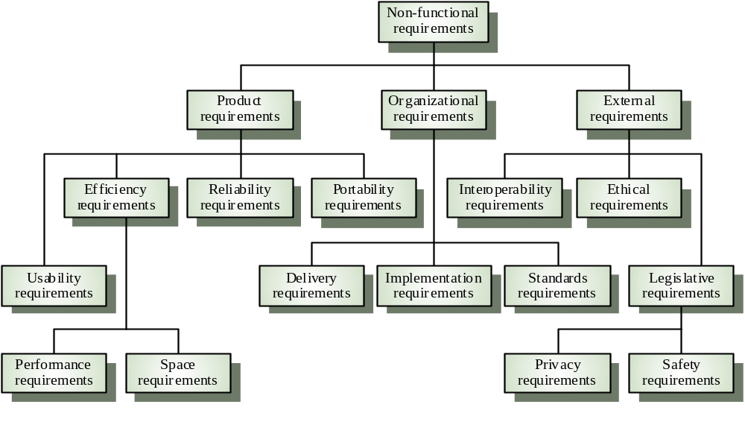
Various NFR Types
Failures Requirements Definition/Importance Requirements Types Development Process Requirements Activities
Other ontologies also exist
Source: Gerald Kotonya and Ian Sommerville, Requirements Engineering – Processes and Techniques, Wiley, 1998

Slide 28
Examples of Non-Functional Requirements
Failures Requirements Definition/Importance Requirements Types Development Process Requirements Activities
Product requirement
  It shall be possible for all necessary communication between the system and the user to be expressed in the standard character set.
Process requirement
  The system development process and deliverable documents shall conform to the process and deliverables defined in the standard XYZ.
Security requirement
  The system shall not disclose any personal information about customers apart from their name and reference number to the operators of the system.

Slide 29
Measurable Non-Functional Requirements
Failures Requirements Definition/Importance Requirements Types Development Process Requirements Activities
Property
Measure
Speed
Processed transactions/second
User/Event response time
Screen refresh time
Size
K Bytes
Number of RAM chips
Ease of use
Training time
Number of help frames
Reliability
Mean time to failure
Probability of unavailability
Rate of failure occurrence
Availability
Robustness
Time to restart after failure
Percentage of events causing failure
Probability of data corruption on failure
Portability
Percentage of target dependent statements
Number of target systems
Source: Gerald Kotonya and Ian Sommerville, Requirements Engineering – Processes and Techniques, Wiley, 1998

Slide 30
Other“Requirements”
Failures Requirements Definition/Importance Requirements Types Development Process Requirements Activities
A user requirement is a desired goal or function that a user and other stakeholders expect the system to achieve
  Does not necessarily become a system requirement
Application domain requirement (sometimes called business rules) are requirements derived from business practices within a given industrial sector, or in a given company, or defined by government regulations or standards.
  May lead to system requirements. Can be functional or non-functional

Slide 31
Application-Domain Requirements
Failures Requirements Definition/Importance Requirements Types Development Process Requirements Activities
Derived from the application domain
Describe system characteristics and features that reflect the domain
May be new functional requirements, constraints on existing requirements, or define specific computations
If domain requirements are not satisfied, the system may be unworkable

Slide 32
Examples of Application-Domain Requirements
Failures Requirements Definition/Importance Requirements Types Development Process Requirements Activities
Library system
  The system interface to the database must comply with standard Z39.50.
  Because of copyright restrictions, some documents must be deleted immediately on arrival. Depending on the user’s requirements, these documents will first be printed either locally or printed to a network printer and retrieved by the user.
Train protection system
  The deceleration of the train shall be computed as:
  D_{train} = D_{control} + D_{gradient}
  where D_{gradient} is 9.81ms² * compensated gradient / alpha and where the values of 9.81ms² / alpha are known for different types of train.

Slide 33
Problems concerning Application-Domain Requirements
Failures Requirements Definition/Importance Requirements Types Development Process Requirements Activities
Understandability
  Requirements are expressed in the language of the application domain
  This is often not understood by software engineers developing the system
Implicitness
Domain specialists understand the area so well that they do not think of making the domain requirements explicit
  People are often unaware of the tacit knowledge they possess and therefore cannot express it to others

Slide 34
Emergent Properties (when the system consists of several sub-systems)
Failures Requirements Definition/Importance Requirements Types Development Process Requirements Activities
Properties of the system as a whole
  Requirements which cannot be addressed by a single component, but which depend for their satisfaction on how all the software components interoperate
  Only emerge once all individual subsystems have been integrated
  Dependent on the system architecture
Examples of emergent properties
  Reliability
  Maintainability
  Performance
  Usability
  Security & Safety

Slide 35
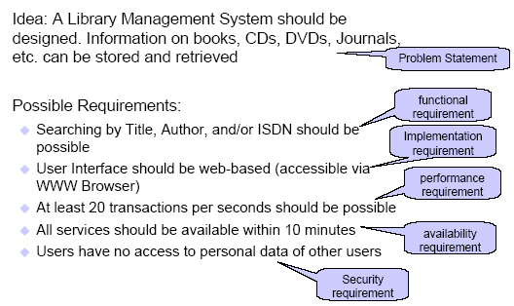

Slide 36
Types of Requirements – Contd…
Important note: Software Requirements Engineering is a special case of Requirements Engineering. Many topics discussed in this course are quite general and apply to requirements engineering, in general.
In a system containing software, software requirements are derived from the system requirements. The system then consists of hardware and software, and the hardware (and often the operating system and other existing software modules) are part of the environment in which the software is used.

Slide 37
Goals
Failures Requirements Definition/Importance Requirements Types Development Process Requirements Activities
A Goal
  Conveys the intention or the objective of one or many stakeholders
  Can guide the discovery of verifiable non-functional requirements that can be tested objectively

Slide 38
Example of Goal and NFR
Failures Requirements Definition/Importance Requirements Types Development Process Requirements Activities
A system goal
  The system should be easy to use by experienced controllers and should be organized in such a way that user errors are minimized.
A verifiable usability requirement derived from this goal
  Experienced controllers shall be able to use all the system functions after a total of three hours of training.
  The average number of errors made by experienced controllers shall not exceed two per day.
  Assumption: An experienced controller has at least 2 years experience with the old system (as stated by the stakeholder)

